Slide 1
Smart Mirror
Bobin George Varghese
A Dinesh Udayasankar
Vishnu V Nair
Suraj Kundoor

Slide 2
Index
Introduction
System Analysis
System Specification
System Design
Literature Survey
Implementation
Conclusion

Slide 3
Introduction

Slide 4
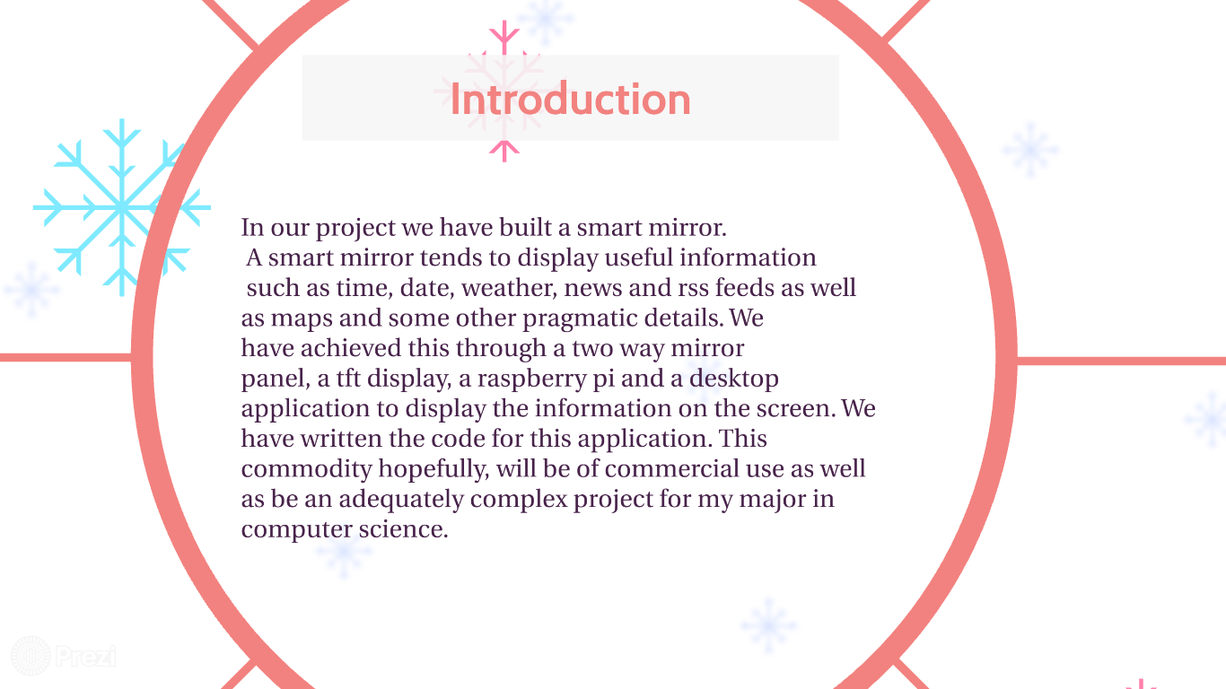

Slide 5
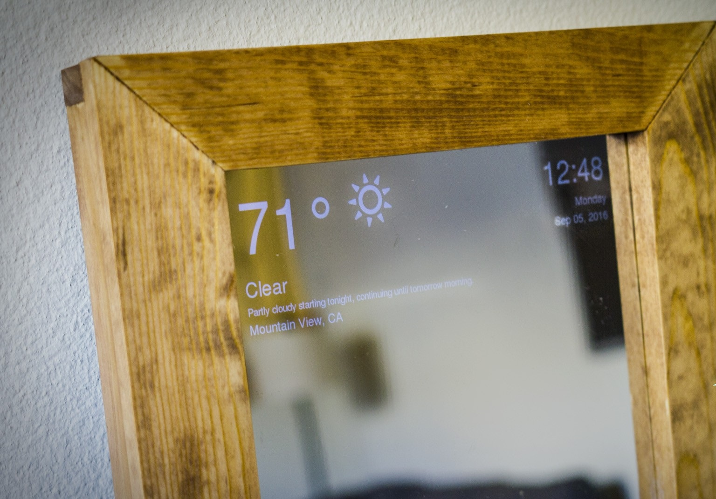
Proposed System
This system isbased on raspberry pi .
Paired with a double sided mirror gives more intent compared to that of a normal mirror
Makes every look in the mirror knowledgable

Slide 6
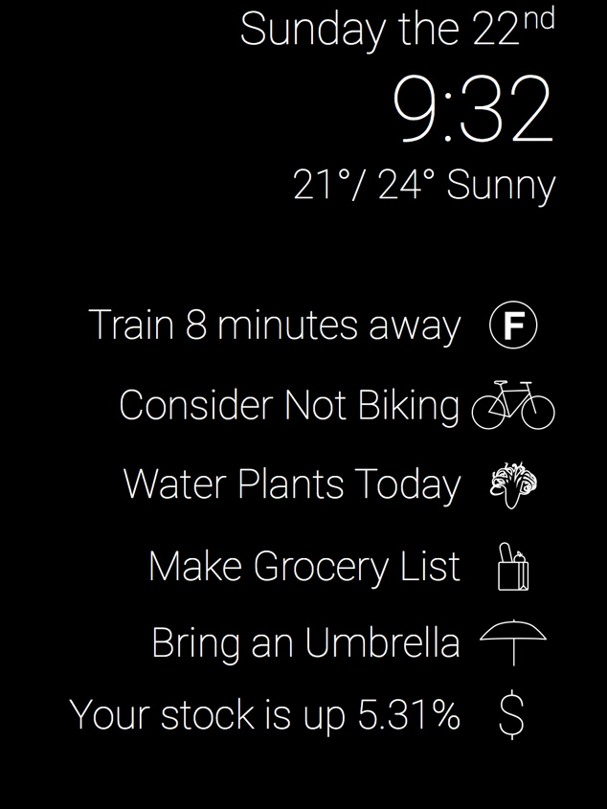
Advantages of Proposed System
Notifications of time ,weather,etc..
24/7
Does not interfere with reflection of ones self
One can keep track of time and traffic while getting dressed itself.

Slide 7
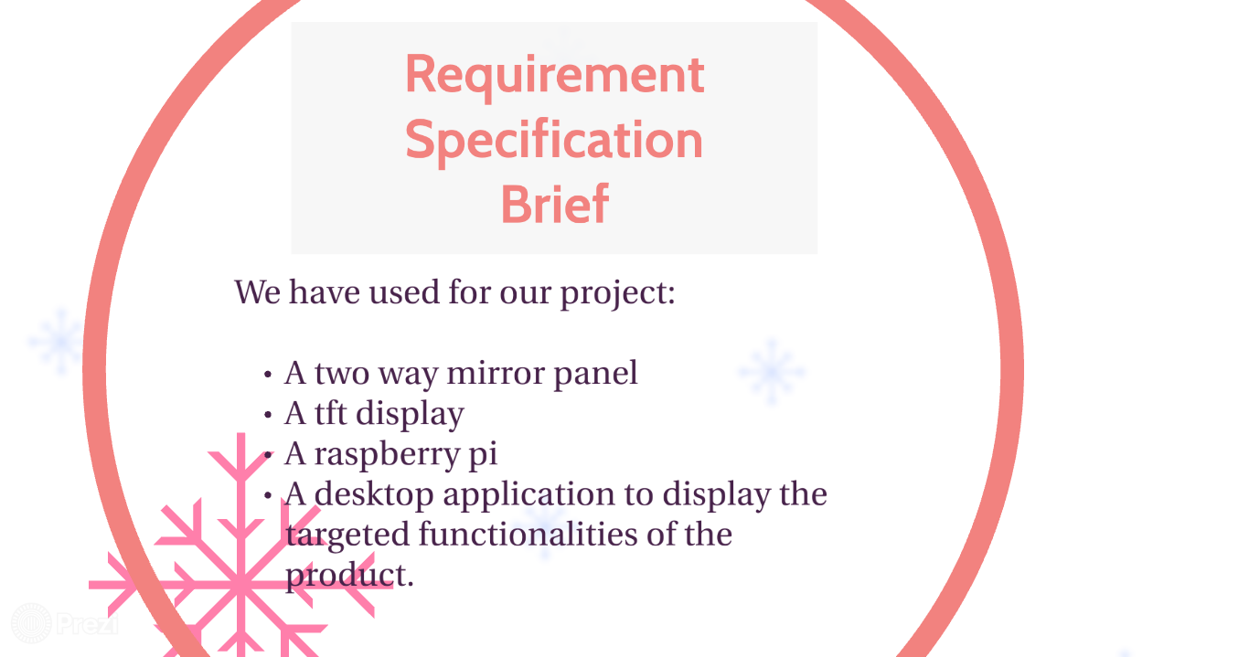

Slide 8
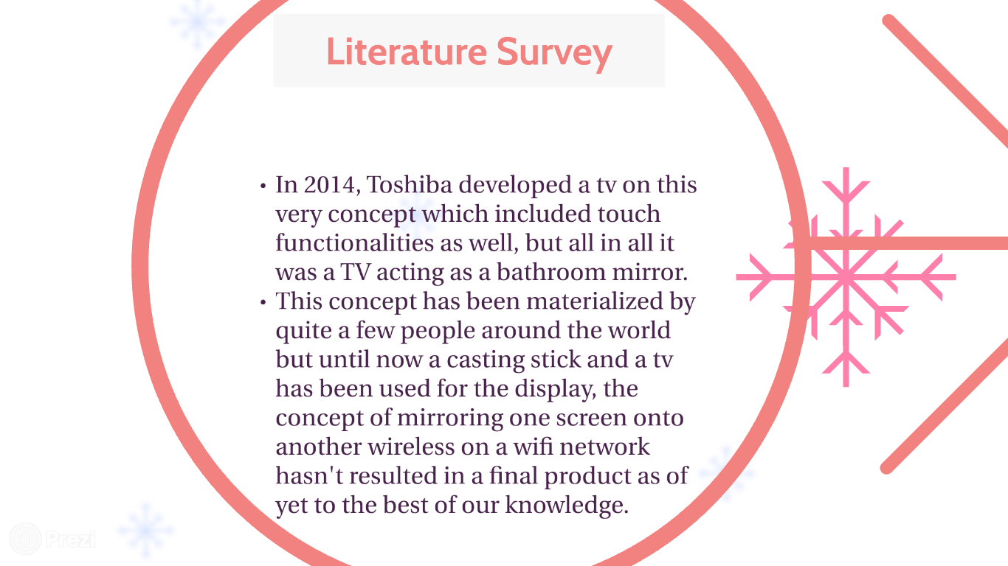

Slide 9
Implementation

Slide 10
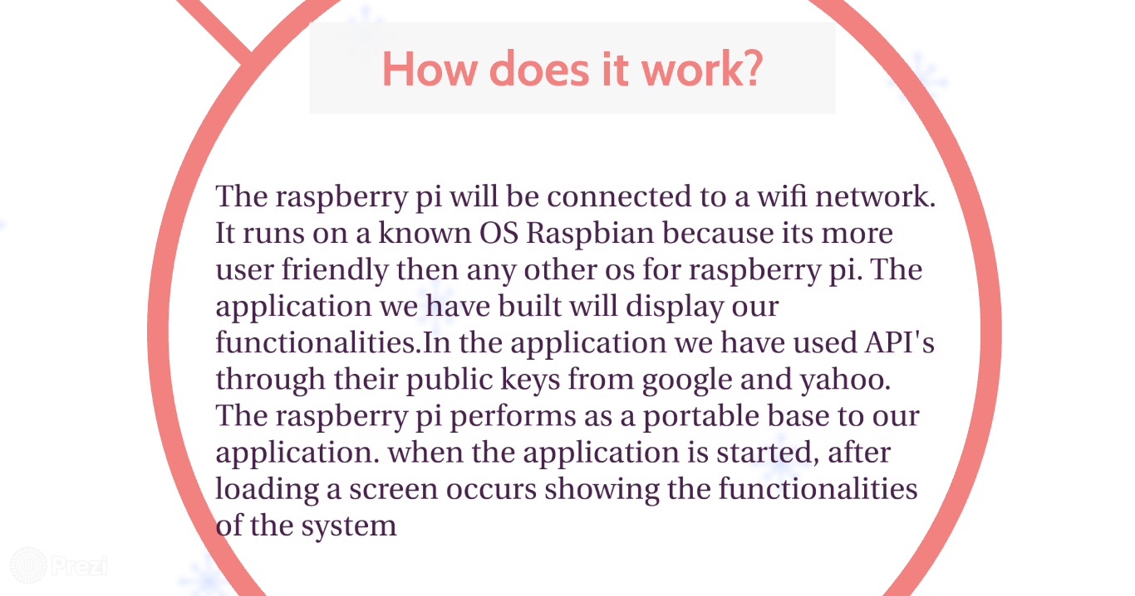

Slide 11
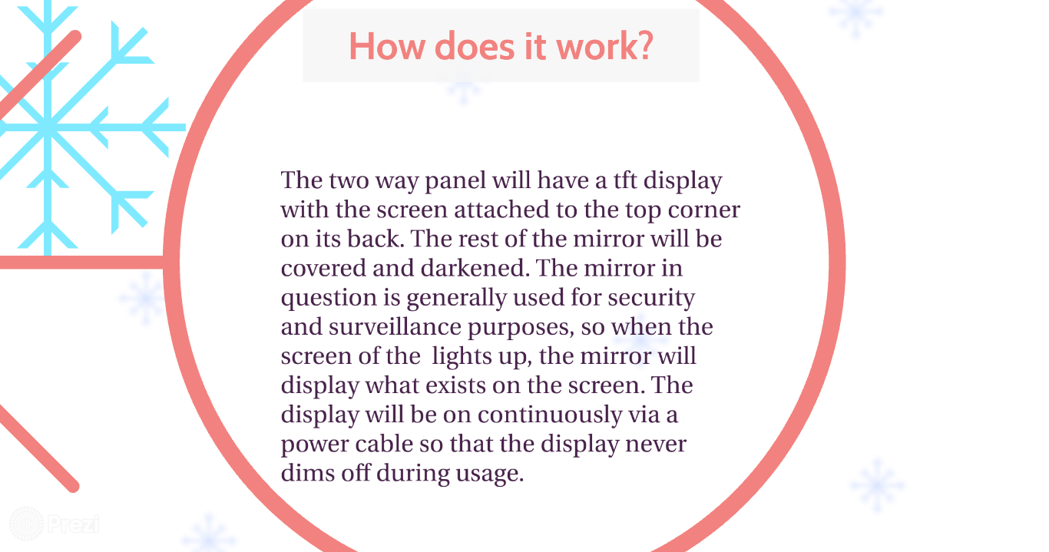

Slide 12
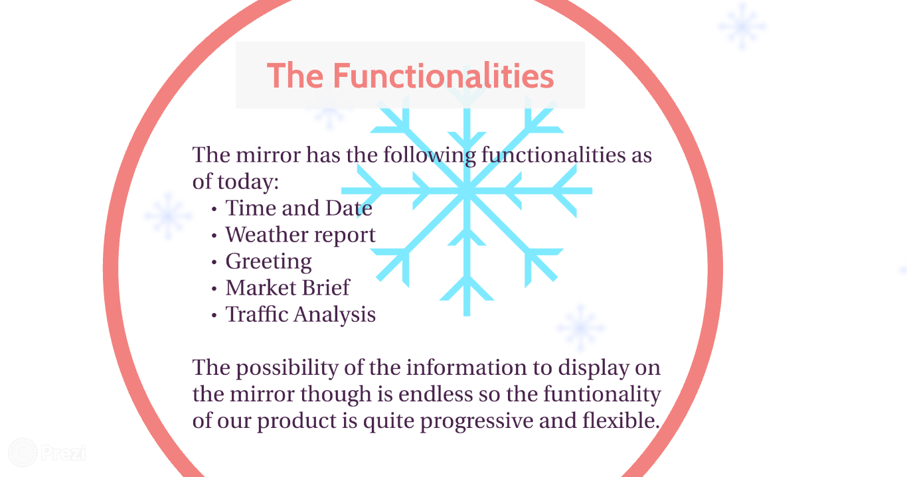

Slide 13
Conclusion
This project makes use of the raspberry pi to make the daily use of a mirror into a fun and cool way to get some notifications that are really important to us.
There are more versions of the smart mirrors out there which use voice and facial recognition,and those are powered by a more powerful CPU's like desktop or laptop CPU's .
This project is a fun prospect of making one the most basic things in our day to day life knowledgable.

Slide 14
